Slide 1
P44 - Multimodal VR Simulation with Inverse3 Haptic Device
Group: SOFT3888_TU12_02_P44
Client: FMH Media Lab
Tutor: Islam Alzoubi
Tutorial: Tuesday 12PM

Slide 2
Agenda
Progress Overview
User Stories
Functional and Non-Functional Requirements
Deployment Plan
Testing Plan
Potential Risks
Improvements

Slide 3
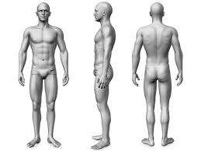
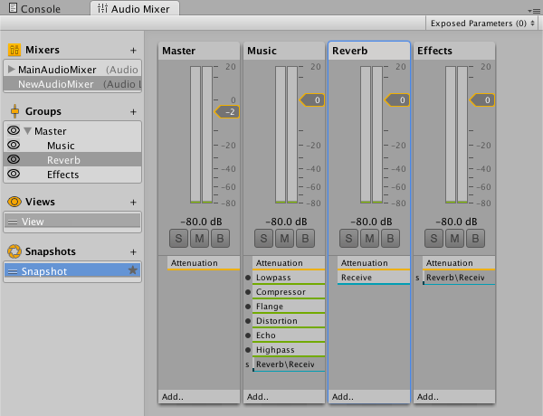
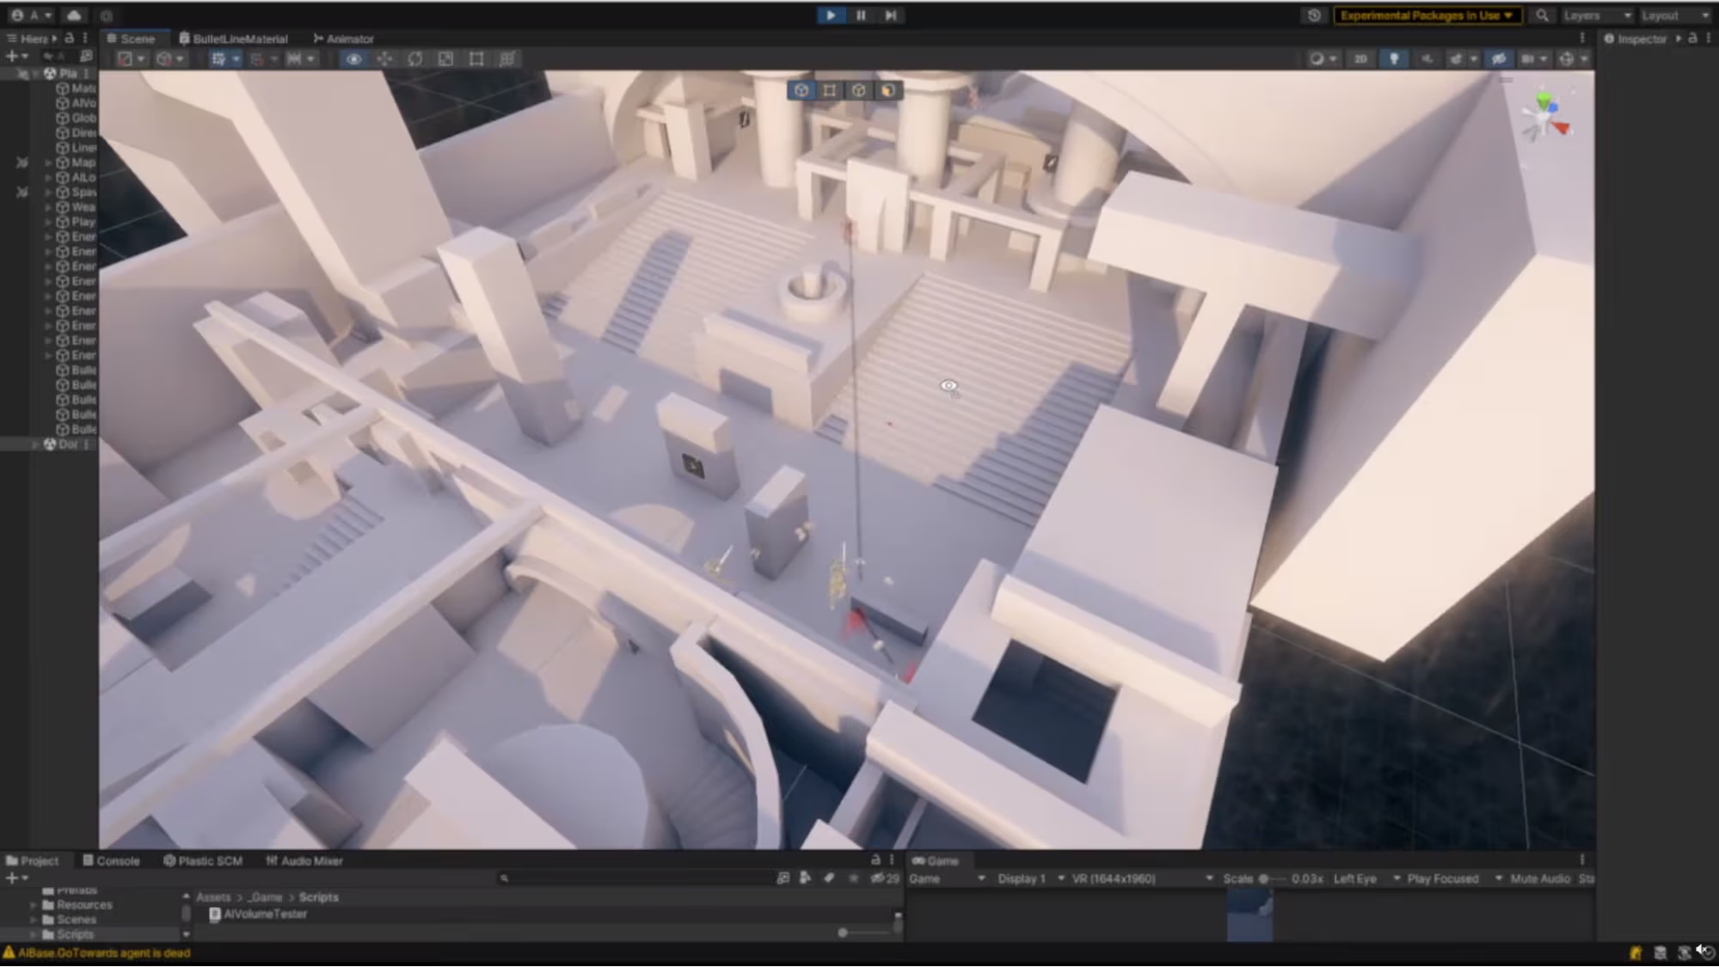
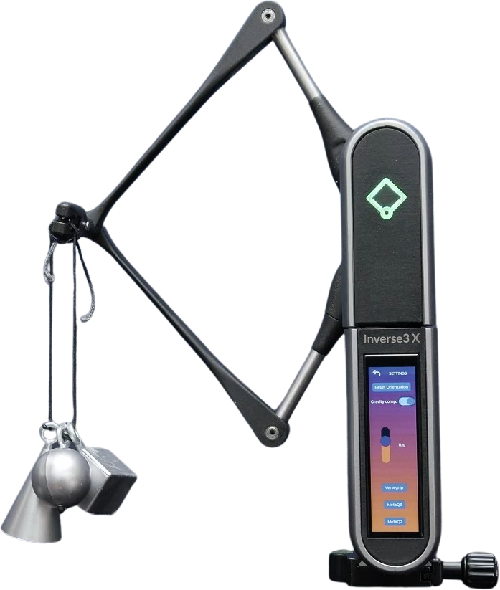
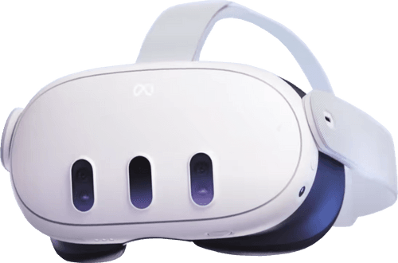
Our Team
3D Modeller
Level & Audio Engineers
Bassam Batch
bbat2575 - 310229251
Samiksha Aveg
save8683 - 510574673
Catherine Kim
ckim4493 - 530319263
Hardware Specialists
Instrumentation Engineer
Destinee Horvath
dhor0241 - 530490838
Eve Bowyer
ebow2770 - 520431443
Jeslyn Bowman
jbow2146 - 530481526
David Ryder
dryd4252 - 530570130
Notes:
We have 3 roles: 1, 2, 3
name name and name is in the team name

Slide 4
Progress Overview
Deliverables completed:
Level design and 3D modeling
Patient breathing animation
Scene and device integration
Technical Documentation
Works in progress:
Accurate Inverse 3 force feedback (with calibrated material library)
Positioning Meta Quest 3 (trialling in progress)
Recreate model (arm anatomy + manual animations)
Notes:
Deliverables completed:
Level design + 3D modelling
Created realistic human patient model with arm extended for syringe insertion. Modelled the pressure points to distinguish correct injection locations for simulation.
Acquired 3D doctor’s room model and refactored scene elements. Integrated various lighting features to enhance user experience and overall immersion
Patient breathing
Built accurate breathing animation for human model; allows for realistic injection practice
Scene and device integration
Integrated all scene elements (room + human) and configured both devices to function correctly in Unity.
Technical documentation
Keeping track of software and hardware requirements in github wiki
Creative commons licencing
User stories
Google drive + meeting minutes contains error logs/fixes that were experienced in device testing
Works in progress
Accurate force feedback
Moved onto configuring Unity rigidbodies to provide accurate force feedback to the Inverse 3.
Testing smoothing scripts and exponential calculations to stop inverse 3 jitters using interpolation
3 key materials to detect: skin, vein, muscle - force calculations
Meta Quest 3 syncing
Trialled with paper
Rough design ideas for headset hanger centred on Inverse 3 clamp -> 3D print?
Velcro / felt for protection + stability
Stretch goal
If feeling ambitious -> simulate the desired arm-tissue syringe insertion scenario with accurate haptic resistance

Slide 5
Non-Functional Requirements
As a customer…
I want the simulation to run smoothly so that users experience responsive VR interactions without lag or jitter. | NFR-01: Performance
I want an appealing environment that accurately represents a typical medical setting so that users feel immersed in a realistic scenario. | NFR-02: Accuracy + Realism
I want the simulation to be bug-free and properly tested so that users can rely on the system for accurate haptic interactions. | NFR-03: Usability
I want Unity set up with the required SDKs so that my VR–haptic system can be built on a reliable foundation. | NFR-03: Scalability
Notes:
FUNCTIONAL:
Integrate Unity VR application with Inverse3 haptic device and Meta Quest 3 headset
Enable real-time haptic feedback for interactions (<50ms latency)
Implement at least three distinct material profiles with different tactile sensations
Develop syringe insertion and blood draw simulation with realistic resistance
Deliver technical documentation: API integration, developer setup, user guide
NON-FUNCTIONAL
Performance: Maintain latency under 50ms and stable frame rates
Accuracy & realism: Haptic feedback must match real-world tissue properties
Reliability: Application runs stably on desktop VR setup without desynchronisation
Usability: Users can reliably distinguish material profiles
Scalability: System supports future feature expansion

Slide 6
Functional requirements
As a customer…
I want the software (Unity) and hardware (VR and haptic device) to work seamlessly so that users can interact with the simulation without technical issues. | FR-01: Integrate Unity with haptic and VR
I want the haptic device to give realistic feedback so that users can feel the physical properties of virtual materials accurately. | FR-02: Real-time haptic feedback FR-03: At least 3 distinct material profiles
As a developer…
I want clear documentation so that I can troubleshoot errors, maintain the system, and assist users effectively. | FR-04: Technical documentation detailing development process and product set-up instructions

Slide 7
Developed User Stories
User Story Number | Description | Status
US01 | As a customer, I want to easily set up driver support for the Meta Quest headset and Inverse3 haptic support. | Complete
US02 | As a customer, I want an appealing environment that accurately represents a typical medical setting so that users feel immersed in a realistic scenario. | Complete
US03 | As a customer, I want the software and hardware to work seamlessly so that users can interact with the simulation without technical issues. | Complete
Notes:
Hardware Limitation
Project is limited to desktop VR setup + Meta Quest 3 headset
Only the Inverse3 haptic device is supported (no other haptic devices)
Software / SDK Constraints:
Must use Unity engine for VR simulation
Integration relies on Meta Quest SDK and Inverse3 SDK/API
Limited to features provided by these SDKs -> cannot extend beyond supported APIs
Performance Boundaries
End-to-end latency must stay under 50ms for haptic and VR feedback
Limited by the processing power of the desktop and Unity’s real-time performance
Project Timeline:
All milestones and deliverables must be completed within the 12-week schedule

Slide 8
Testing Plan & Acceptance Criteria
Test | Acceptance Criteria
Unit & Integration | Unity scripts Inverse 3 SDK VR headset communicate correctly.
Performance | Latency <50ms. Stable frame rates. No desynchronisation
User | Trials with participants.
Notes:
Unit and Integration Testing
Verify Unity scripts, Inverse3 SDK, and VR headset work together
Functional Testing
Check material profiles, syringe insertion, and blood draw simulation for realistic haptic feedback
Performance Testing
Ensure latency <50ms, stable frame rates, no desynchronisation
User Testing
Trials with participants to evaluate accuracy and realism of material identification

Slide 9
Future Plan
Tweaking haptic experience
Accurate material feedback.
Headset hook.
Model animations.
UI (out of bounds, successful and unsuccessful injection).
Adding realism to simulation (sound, extra assets).
Notes:
Our steps going forward are:
Tweaking the haptic experience
Doing user testing on the material feedback
Synchronising the Inverse3’s cursor position with the Meta Quest 3 using a headset hook
As was previously mentioned, we’ve had some issues with customising Mixamo’s animations, so we’re going back and creating our own custom animations
Adding in UI warnings for moving the Inverse3 or the Meta Quest 3 too far away
We’re also looking to add audio cues to the simulation to assist the user in giving correct injections.

Slide 10
Potential Risks
Calibration and realism of haptic feedback
Unity and Inverse 3 API integration difficulties
Latency/performance issues in haptic feedback
Limited device access for testing and development
System crashes or instability during demos
Unrealistic material feedback leading to poor user experience
Notes:
Our project has many potential risks, these include:
Calibration and realism of the haptic feedback
Unity and Inverse3 API integration difficulties
Latency/performance issues in haptic feedback
Limited device access for testing and development
Stretch goal feasibility within timeframe
System crashes or instability during demos
Unrealistic material feedback leading to poor user experience

Slide 11
Deployment Plan
VR simulation with real-time haptic feedback
Executed on local machine through Unity
Simulation is designed for the Inverse3 Haptic Device and Meta Quest 3 headset
Guide for headset and haptic device connection issues
Documentation provided for setup, usage, and support

Slide 12
Demo
Any questions?

